Slide 1
Different type of cable network

Slide 2
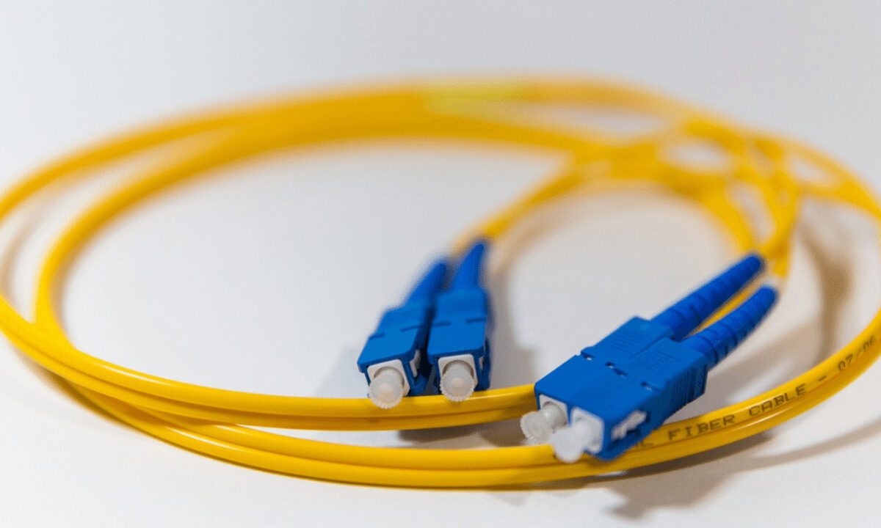
What are the different types of cable network?
Network cables can be divided into four types: coaxial, shielded twisted pair (STP), unshielded twisted pair (UTP), or fibre optic

Slide 3
What is the full form of network?
The term “NETWORK” does not have a standard full form, as it is not an acronym. It is a word used to describe a group of interconnected entities, such as computers, devices, or people, that are able to communicate and share resources.

Slide 4
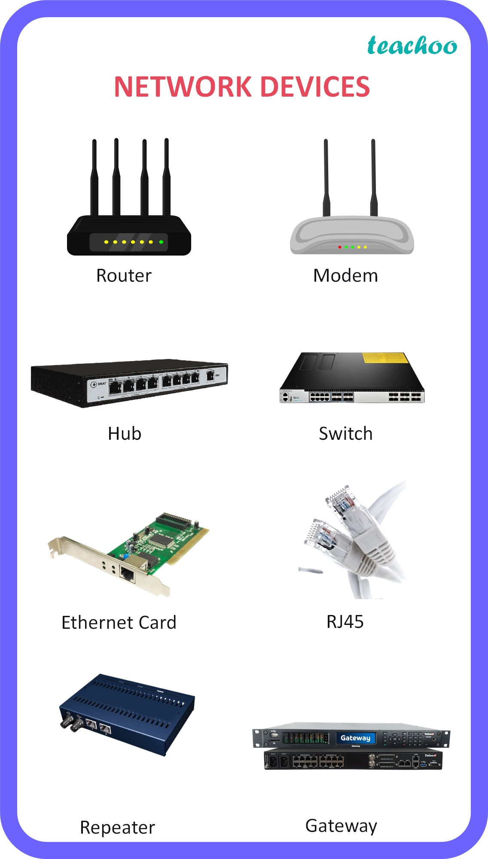
What is a network device?
A network device is a node in the wireless mesh network. It can transmit and receive wireless HART data and perform the basic functions necessary to support network formation and maintenance. Network devices include field devices, router devices, gateway devices, and mesh hand-held devices. (a) Field devices.

Slide 5
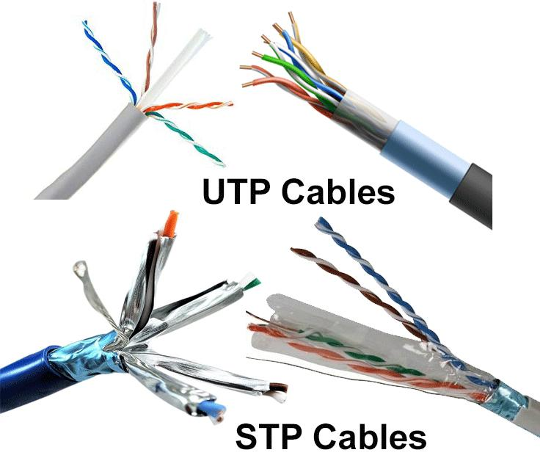
Similarities and differences between STP and UTP cables -
Both STP and UTP can transmit data at 10Mbps, 100Mbps, 1Gbps, and 10Gbps. Since the STP cable contains more materials, it is more expensive than the UTP cable. Both cables use the same RJ-45 (registered jack) modular connectors. Both cables can accommodate a maximum of 1024 nodes in each segment. The STP provides more noise and EMI resistance than the UTP cable. The maximum segment length for both cables is 100 meters or 328 feet.

Slide 6

What are the different network media?
Typical examples of network media include copper coaxial cable, copper twisted pair cables and fiber-optic cables used in wired networks, and radio waves used in wireless data communications networks.

Slide 7
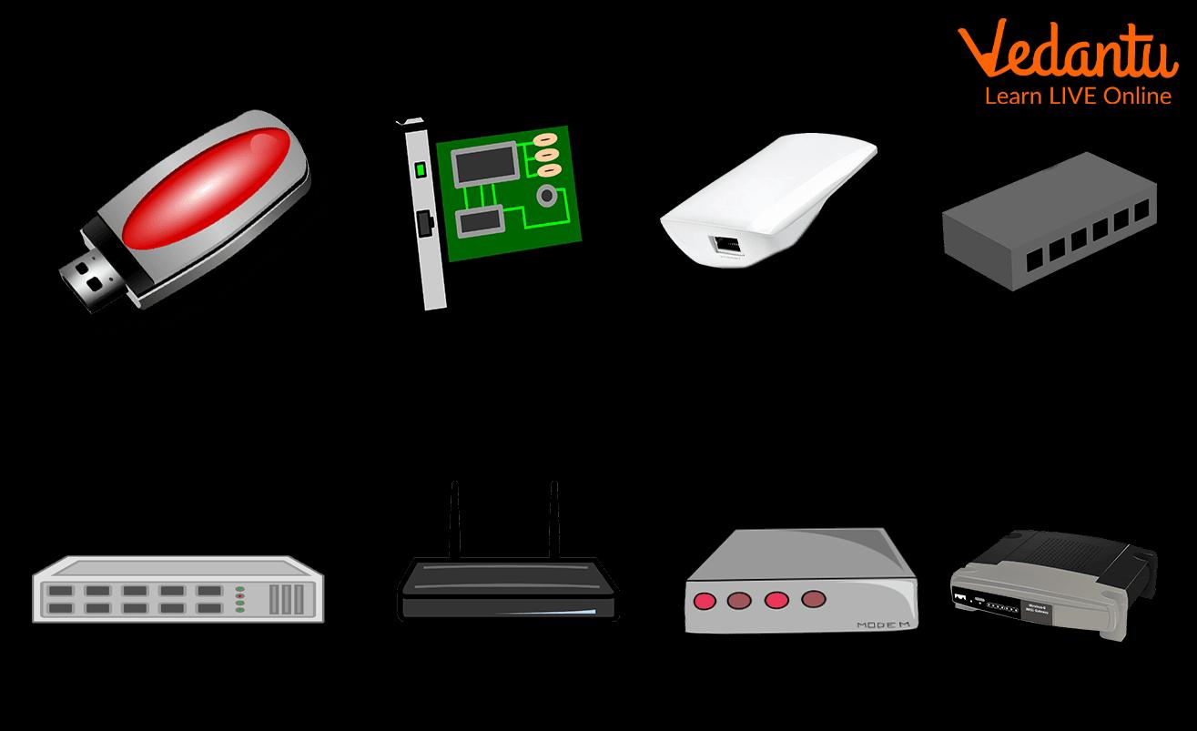
What are 4 devices needed to connect to the internet?
To connect to the internet, all you require is a modem, a wireless router, a computer or smartphone, and an internet connection from an internet service provider.

